Slide 1
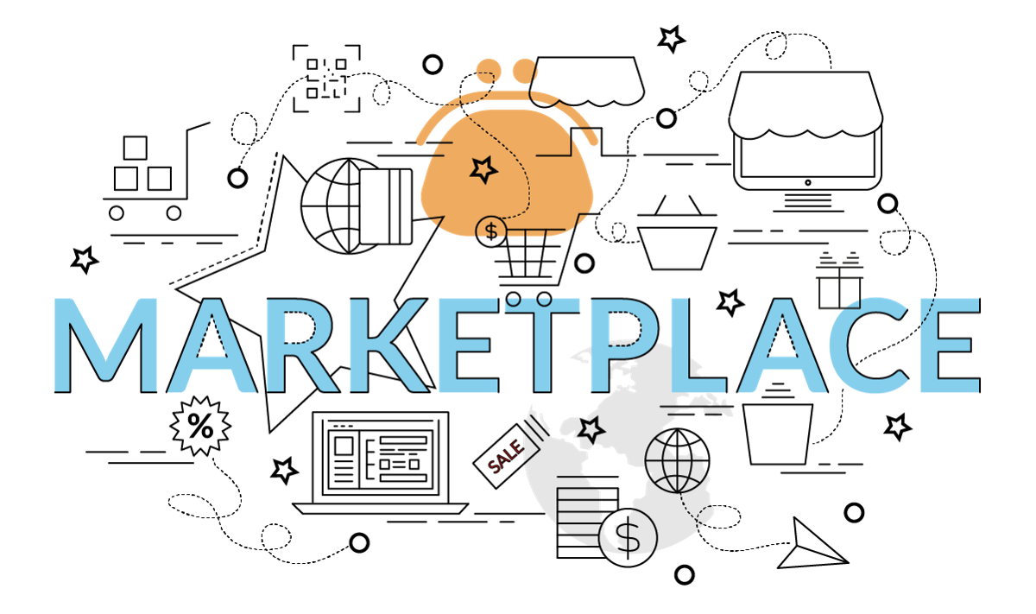
A Decentralized online Marketplace Application (Dapp) on the Ethereum Blockchain

Slide 2
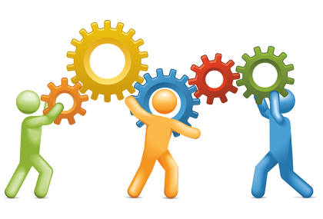
Team Members(B22BH01)
Sri Ritwik Chekuri(S20190010032)
Bhima Shankar Devarakonda(S20190010044)
Mahesh Chennaboina(S20190010033)
Mentor : Dr. Bheemappa Halavar

Slide 3
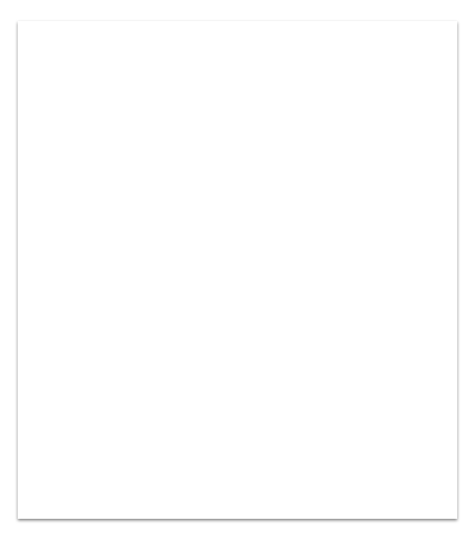

What is a marketplace?
A place where multiple sellers sell their products, just like a shopping mall.
Online marketplace - provides platform to connect buyers and sellers.
Current big players - amazon, flipkart, ebay etc.

Slide 4
Problems with existing market places
Product listing/ selling fees
Privacy of user data
Company holds the central position
Third party payment systems

Slide 5
Problem Statement
To build an application that is not administration centric, no middlemen and provides utmost security.
So, all the user data(mainly address) must be secured.
User’s transactions must be secure.
Sellers should make maximum possible profits.
Buyers need to buy at minimum affordable prices.

Slide 6
#Case Study : eBay data breach
One such big problem is the ebay data breach in 2014 with the risk of 145M User’s data being stolen
Ebay asked it’s users to change their passwords
Problem
eBay is one of the biggest online marketplace. Now the biggest fear is, “if ebay’s data was at risk”, how can one trust anything as such.

Slide 7
Of all the drawbacks and case study mentioned above
The data and transactions are centralised.
A single entity/group can control/have power
over the users.
Solution
We have to think of the approach where the data and transactions become decentralised.

Slide 8
Decentralization
The power to take a decision is distributed.
A consensus among the users is used to take decision/decide future changes.
This helps to remove the middlemen between the customer and seller.
Can decentralisation solve all the issues?
Why not??
Eg: BitTorrent

Slide 9
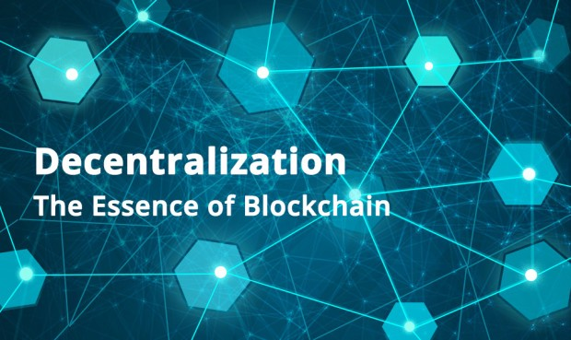
Blockchain - implements decentralisation in the best way.
No single person or group has control - rather all users collectively retain control.

Slide 10
What is BlockChain Technology?
A peer-to-peer network that maintains a distributed ledger containing all the records.
These transactions are stored using an immutable cryptographic signature.
Ledger is visible to anyone and everyone have a copy of the it.
No tampering can be done to the information on blockchain.

Slide 11
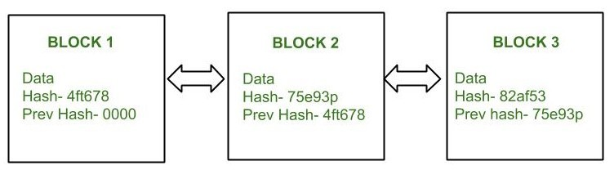
Structure of a Block
A Header , which contains the HASH of the present block.
Body, which contains the list of all transactions needed to be validated.
The Hash of the previous block which maintains the connection between the blocks.
Decentralisation, enhanced-security, immutability

Slide 12
Why Blockchain in marketplaces??
It reduces costs associated with using the platform. Therefore, it is not expensive for the seller to list or sell an item, thereby driving the prices for the buyers down.
Users have the ownership of their data and can safeguard their data.
Replace middlemen and automate the process..
No longer worry about the data breaches.
Finally applications with no central point of failure.
Not to build trust but remove the need for trust.

Slide 13
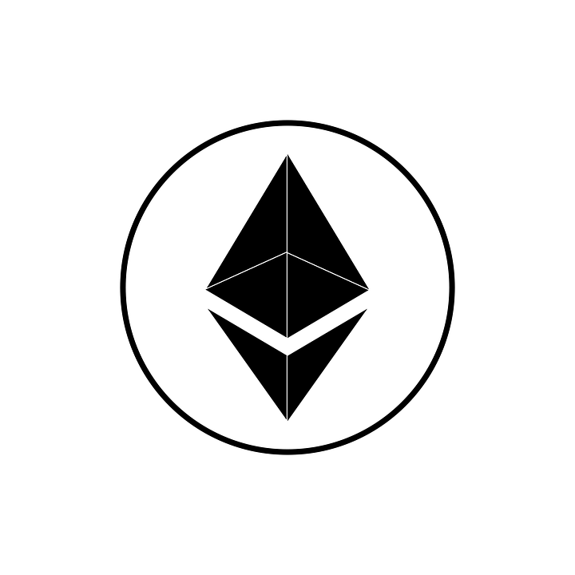
What is Ethereum ?
enables developers to build and deploy decentralized applications.
“smart contracts” - set of rules that executes when an event is triggered and thus automate the workflow
Ether(ETH) - ethereum’s crypto currency .

Slide 14
#Existing System :
A Decentralized Marketplace Application on the Ethereum Blockchain
V. P. Ranganthan, R. Dantu, A. Paul, P. Mears and K. Morozov, "A Decentralized Marketplace Application on the Ethereum Blockchain," 2018 IEEE 4th International Conference on Collaboration and Internet Computing (CIC), 2018, pp. 90-97, doi: 10.1109/CIC.2018.00023.
Description | Tools and technologies used | Test results(RinkeBy test framework)
Kind of a auction based application. Each buyer bids for the product. | Smart contracts- solidity Testing framework - truffle Web3.js - to interact with ethereum node Ganache - local development framework which provides free ether and gas. | Average time taken for Transaction is 3.8sec. Gas consumption for transaction is 4.6 gwei. Contract creation time is less than 1 sec.

Slide 15
Our Plan
As of now, we just had a basic overview of blockchain and read the above paper.
Blockchain type - public, permissioned.
Just to start with, we would like to mimic the architecture used in the paper and implement using the same technologies.
As we progress, we will get to know what’s best for our application.
We will also refer to current existing decentralized marketplaces and adopt the best things in our application.

Slide 16
Timeline
March 2022
October 2022
December 2022
April 2022
Proposing problem statement and getting a basic overview of blockchain
Try to complete the implementation of smart contracts.
Spring semester |  |  |  | Monsoon Semester
Learning all the tools and technologies required, setting up ethereum env and starting with the implementation part
Testing the final product and to showcase a market ready application.

Slide 17
References
Ranganthan, V. P., Dantu, R., Paul, A., Mears, P., & Morozov, K. (2018, October). A decentralized marketplace application on the ethereum blockchain. In 2018 IEEE 4th International Conference on Collaboration and Internet Computing (CIC) (pp. 90-97). IEEE. (Paper)
https://www.edureka.co/blog/category/blockchain/ (Blog)
https://www.youtube.com/watch?v=jxLkbJozKbY&ab_channel=99Bitcoins (video)
https://www.devteam.space/blog/how-to-build-online-marketplace-on-blockchain-like-openbazaar/ (Blog)
https://jimmysong.medium.com/the-truth-about-smart-contracts-ae825271811f (Blog)

Slide 18
–Thank you–
We mean it.

